Slide 1
Elementary Linear Algebra
Anton & Rorres, 9th Edition
Lecture Set – 07
Chapter 7:
Eigenvalues, Eigenvectors

Slide 2
Chapter Content
Eigenvalues and Eigenvectors
Diagonalization
Orthogonal Digonalization
115/11/08
Elementary Linear Algebra

Slide 3
7-1 Eigenvalue and Eigenvector
If A is an n×n matrix
  a nonzero vector x in R^{n} is called an eigenvector of A if Ax is a scalar multiple of x;
  that is, Ax = λx for some scalar λ.
  The scalar λ is called an eigenvalue of A, and x is said to be an eigenvector of A corresponding to λ.
115/11/08
Elementary Linear Algebra

Slide 4
7-1 Eigenvalue and Eigenvector
Remark
  To find the eigenvalues of an n×n matrix A we rewrite Ax = λx as Ax = λIx or equivalently, (λI – A)x = 0.
  For λ to be an eigenvalue, there must be a nonzero solution of this equation. However, by Theorem 6.4.5, the above equation has a nonzero solution if and only if det (λI – A) = 0.
  This is called the characteristic equation of A; the scalar satisfying this equation are the eigenvalues of A. When expanded, the determinant det (λI – A) is a polynomial p in λ called the characteristic polynomial of A.
115/11/08
Elementary Linear Algebra

Slide 5
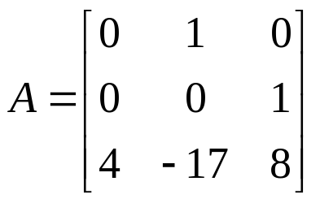
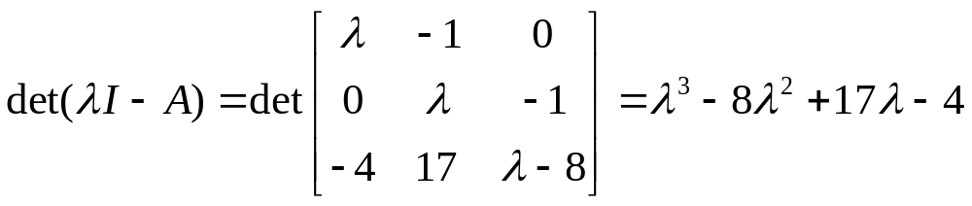
7-1 Example 2
Find the eigenvalues of
Solution:
  The characteristic polynomial of A is
  The eigenvalues of A must therefore satisfy the cubic equation
  λ³ – 8λ² + 17λ – 4 =0
115/11/08
Elementary Linear Algebra

Slide 6
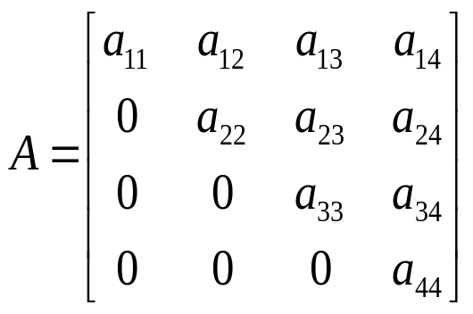
7-1 Example 3
Find the eigenvalues of the upper triangular matrix
115/11/08
Elementary Linear Algebra

Slide 7
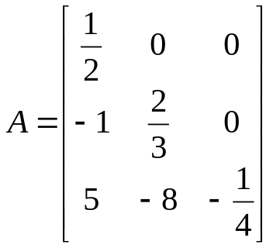
Theorem 7.1.1
If A is an n×n triangular matrix (upper triangular, low triangular, or diagonal)
  then the eigenvalues of A are entries on the main diagonal of A.
Example 4
  The eigenvalues of the lower triangular matrix
115/11/08
Elementary Linear Algebra

Slide 8
Theorem 7.1.2 (Equivalent Statements)
If A is an n×n matrix and λ is a real number, then the following are equivalent.
  λ is an eigenvalue of A.
  The system of equations (λI – A)x = 0 has nontrivial solutions.
  There is a nonzero vector x in R^{n} such that Ax = λx.
  λ is a solution of the characteristic equation det(λI – A) = 0.
115/11/08
Elementary Linear Algebra

Slide 9
7-1 Finding Bases for Eigenspaces
The eigenvectors of A corresponding to an eigenvalue λ are the nonzero x that satisfy Ax = λx.
Equivalently, the eigenvectors corresponding to λ are the nonzero vectors in the solution space of (λI – A)x = 0.
We call this solution space the eigenspace of A corresponding to λ.
115/11/08
Elementary Linear Algebra

Slide 10
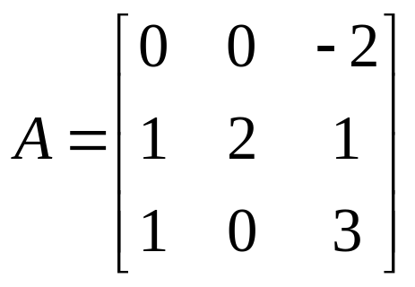
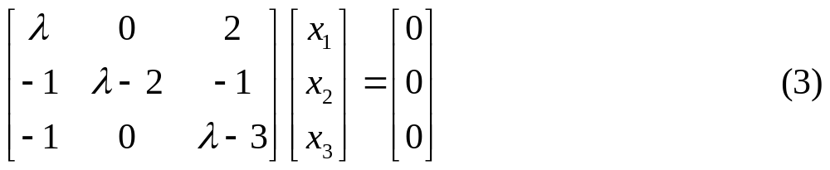
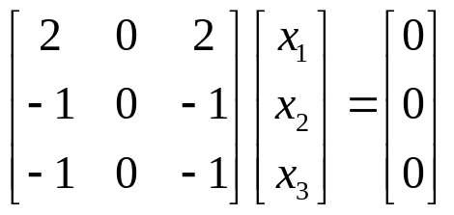
7-1 Example 5
Find bases for the eigenspaces of
Solution:
  The characteristic equation of matrix A is λ³ – 5λ² + 8λ – 4 = 0, or in factored form, (λ – 1)(λ – 2)² = 0; thus, the eigenvalues of A are λ = 1 and λ = 2, so there are two eigenspaces of A.
  (λI – A)x = 0 ⇒
  If λ = 2, then (3) becomes
115/11/08
Elementary Linear Algebra

Slide 11
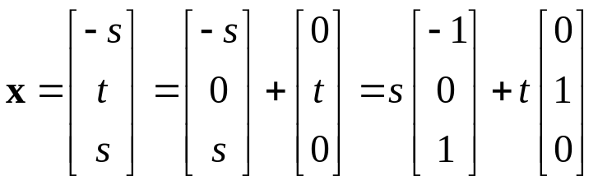
7-1 Example 5
  Solving the system yield
  x₁ = -s, x₂ = t, x₃ = s
  Thus, the eigenvectors of A corresponding to λ = 2 are the nonzero vectors of the form
  The vectors [-1 0 1]^{T} and [0 1 0]^{T} are linearly independent and form a basis for the eigenspace corresponding to λ = 2.
  Similarly, the eigenvectors of A corresponding to λ = 1 are the nonzero vectors of the form x = s [-2 1 1]^{T}
  Thus, [-2 1 1]^{T} is a basis for the eigenspace corresponding to λ = 1.
115/11/08
Elementary Linear Algebra

Slide 12
Theorem 7.1.3
If k is a positive integer, λ is an eigenvalue of a matrix A, and x is corresponding eigenvector
  then λ^{k} is an eigenvalue of A^{k} and x is a corresponding eigenvector.
Example 6 (use Theorem 7.1.3)
115/11/08
Elementary Linear Algebra

Slide 13
Theorem 7.1.4
A square matrix A is invertible if and only if λ = 0 is not an eigenvalue of A.
  (use Theorem 7.1.2)
Example 7
  The matrix A in the previous example is invertible since it has eigenvalues λ = 1 and λ = 2, neither of which is zero.
115/11/08
Elementary Linear Algebra

Slide 14
Theorem 7.1.5 (Equivalent Statements)
If A is an m×n matrix, and if T_{A} : R^{n} → R^{n} is multiplication by A, then the following are equivalent:
  A is invertible.
  Ax = 0 has only the trivial solution.
  The reduced row-echelon form of A is I_{n}.
  A is expressible as a product of elementary matrices.
  Ax = b is consistent for every n×1 matrix b.
  Ax = b has exactly one solution for every n×1 matrix b.
  det(A)≠0.
  The range of T_{A} is R^{n}.
  T_{A} is one-to-one.
  The column vectors of A are linearly independent.
  The row vectors of A are linearly independent.
115/11/08
Elementary Linear Algebra

Slide 15
Theorem 7.1.5 (Equivalent Statements)
  The column vectors of A span R^{n}.
  The row vectors of A span R^{n}.
  The column vectors of A form a basis for R^{n}.
  The row vectors of A form a basis for R^{n}.
  A has rank n.
  A has nullity 0.
  The orthogonal complement of the nullspace of A is R^{n}.
  The orthogonal complement of the row space of A is {0}.
  A^{T}A is invertible.
  λ = 0 is not eigenvalue of A.
115/11/08
Elementary Linear Algebra

Slide 16
Chapter Content
Eigenvalues and Eigenvectors
Diagonalization
Orthogonal Digonalization
115/11/08
Elementary Linear Algebra

Slide 17
7-2 Diagonalization
A square matrix A is called diagonalizable
  if there is an invertible matrix P such that P⁻¹AP is a diagonal matrix (i.e., P⁻¹AP = D);
  the matrix P is said to diagonalize A.
Theorem 7.2.1
  If A is an n×n matrix, then the following are equivalent.
    A is diagonalizable.
    A has n linearly independent eigenvectors.
115/11/08
Elementary Linear Algebra

Slide 18
7-2 Procedure for Diagonalizing a Matrix
The preceding theorem guarantees that an n×n matrix A with n linearly independent eigenvectors is diagonalizable, and the proof provides the following method for diagonalizing A.
  Step 1. Find n linear independent eigenvectors of A, say, p₁, p₂, …, p_{n}.
  Step 2. From the matrix P having p₁, p₂, …, p_{n} as its column vectors.
  Step 3. The matrix P⁻¹AP will then be diagonal with λ₁, λ₂, …, λ_{n} as its successive diagonal entries, where λ_{i} is the eigenvalue corresponding to p_{i}, for i = 1, 2, …, n.
115/11/08
Elementary Linear Algebra

Slide 19
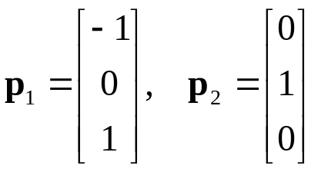
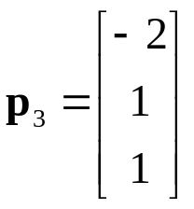
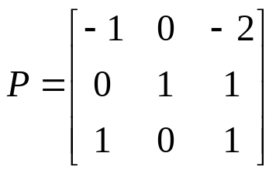
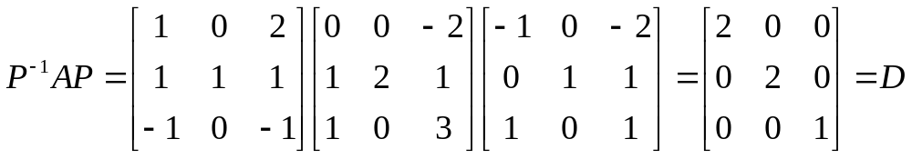
7-2 Example 1
Find a matrix P that diagonalizes
Solution:
  From the previous example, we have the following bases for the eigenspaces:
    λ = 2: λ = 1:
  Thus,
  Also,
115/11/08
Elementary Linear Algebra

Slide 20
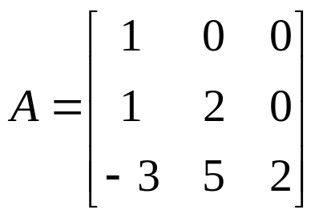
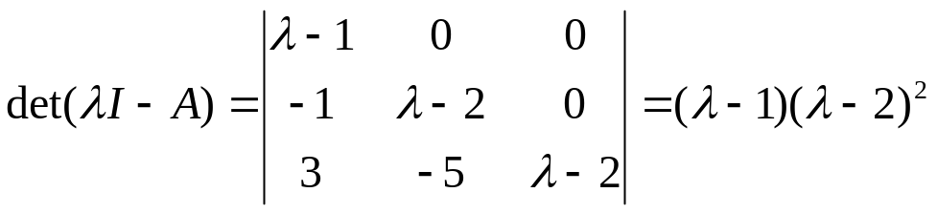
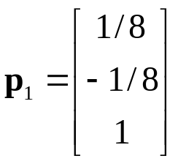
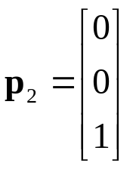
7-2 Example 2
(A Non-Diagonalizable Matrix)
Find a matrix P that diagonalizes
Solution:
  The characteristic polynomial of A is
  The bases for the eigenspaces are
    λ = 1: λ = 2:
  Since there are only two basis vectors in total, A is not diagonalizable.
115/11/08
Elementary Linear Algebra

Slide 21
7-2 Theorems
Theorem 7.2.2
  If v₁, v₂, …, v_{k}, are eigenvectors of A corresponding to distinct eigenvalues λ₁, λ₂, …, λ_{k},
    then {v₁, v₂, …, v_{k}} is a linearly independent set.
Theorem 7.2.3
  If an n×n matrix A has n distinct eigenvalues
    then A is diagonalizable.
115/11/08
Elementary Linear Algebra

Slide 22
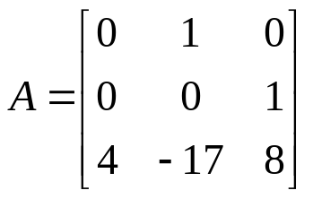

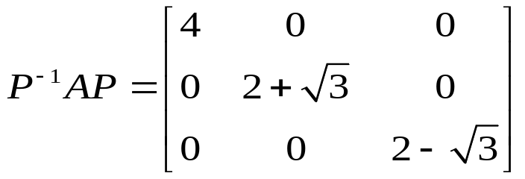
7-2 Example 3
Since the matrix
has three distinct eigenvalues,
Therefore, A is diagonalizable.
Further,
for some invertible matrix P, and the matrix P can be found using the procedure for diagonalizing a matrix.
115/11/08
Elementary Linear Algebra

Slide 23
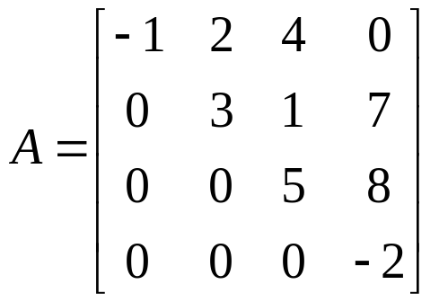
7-2 Example 4 (A Diagonalizable Matrix)
Since the eigenvalues of a triangular matrix are the entries on its main diagonal (Theorem 7.1.1).
Thus, a triangular matrix with distinct entries on the main diagonal is diagonalizable.
For example,
is a diagonalizable matrix.
115/11/08
Elementary Linear Algebra

Slide 24
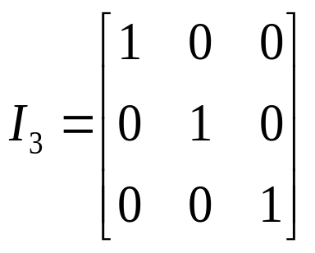
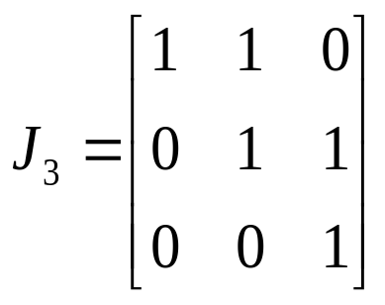
7-2 Example 5
(Repeated Eigenvalues and Diagonalizability)
Whether the following matrices are diagonalizable?
115/11/08
Elementary Linear Algebra

Slide 25
7-2 Geometric and Algebraic Multiplicity
If λ₀ is an eigenvalue of an n×n matrix A
  then the dimension of the eigenspace corresponding to λ₀ is called the geometric multiplicity of λ₀, and
  the number of times that λ – λ₀ appears as a factor in the characteristic polynomial of A is called the algebraic multiplicity of A.
115/11/08
Elementary Linear Algebra

Slide 26
Theorem 7.2.4
(Geometric and Algebraic Multiplicity)
If A is a square matrix, then :
  For every eigenvalue of A the geometric multiplicity is less than or equal to the algebraic multiplicity.
  A is diagonalizable if and only if the geometric multiplicity is equal to the algebraic multiplicity for every eigenvalue.
115/11/08
Elementary Linear Algebra

Slide 27
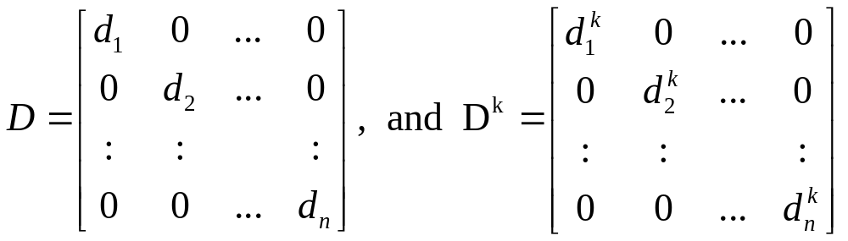
7-2 Computing Powers of a Matrix
If A is an n×n matrix and P is an invertible matrix, then (P⁻¹AP)^{k} = P⁻¹A^{k}P for any positive integer k.
If A is diagonalizable, and P⁻¹AP = D is a diagonal matrix, then
P⁻¹A^{k}P = (P⁻¹AP)^{k} = D^{k}
Thus,
A^{k} = PD^{k}P⁻¹
The matrix D^{k} is easy to compute; for example, if
115/11/08
Elementary Linear Algebra

Slide 28
7-2 Example 6 (Power of a Matrix)
Find A¹³
115/11/08
Elementary Linear Algebra

Slide 29
Chapter Content
Eigenvalues and Eigenvectors
Diagonalization
Orthogonal Digonalization
115/11/08
Elementary Linear Algebra

Slide 30
7-3 The Orthogonal Diagonalization
Matrix Form
Given an n×n matrix A, if there exist an orthogonal matrix P such that the matrix
P⁻¹AP = P^{T}AP
then A is said to be orthogonally diagonalizable and P is said to orthogonally diagonalize A.
115/11/08
Elementary Linear Algebra

Slide 31
Theorem 7.3.1 & 7.3.2
If A is an n×n matrix, then the following are equivalent.
  A is orthogonally diagonalizable.
  A has an orthonormal set of n eigenvectors.
  A is symmetric.
If A is a symmetric matrix, then:
  The eigenvalues of A are real numbers.
  Eigenvectors from different eigenspaces are orthogonal.
115/11/08
Elementary Linear Algebra

Slide 32
7-3 Diagonalization of Symmetric Matrices
The following procedure is used for orthogonally diagonalizing a symmetric matrix.
  Step 1. Find a basis for each eigenspace of A.
  Step 2. Apply the Gram-Schmidt process to each of these bases to obtain an orthonormal basis for each eigenspace.
  Step 3. Form the matrix P whose columns are the basis vectors constructed in Step2; this matrix orthogonally diagonalizes A.
115/11/08
Elementary Linear Algebra

Slide 33
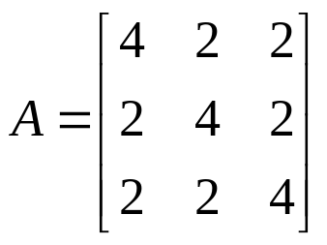
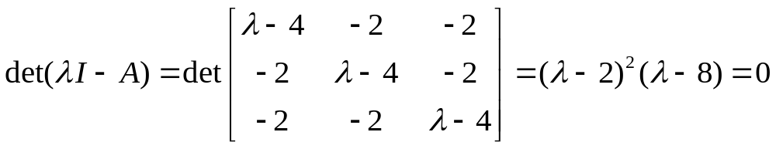
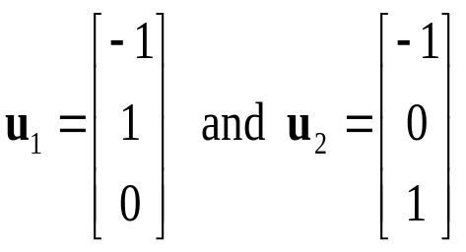
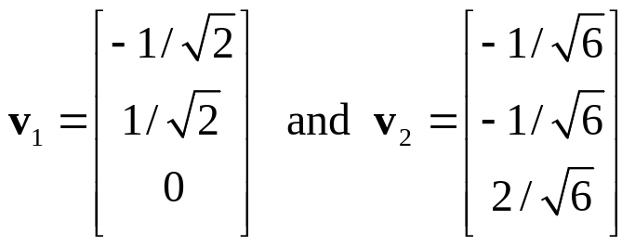
7-3 Example 1
Find an orthogonal matrix P that diagonalizes
Solution:
  The characteristic equation of A is
  The basis of the eigenspace corresponding to λ = 2 is
  Applying the Gram-Schmidt process to {u₁, u₂} yields
  the following orthonormal eigenvectors:
115/11/08
Elementary Linear Algebra

Slide 34
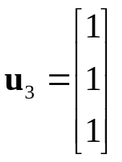
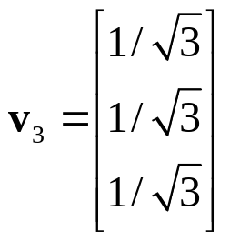
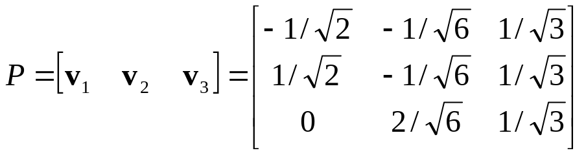
7-3 Example 1
  The basis of the eigenspace corresponding to λ = 8 is
  Applying the Gram-Schmidt process to {u₃} yields:
  Thus,
  orthogonally diagonalizes A.
115/11/08
Elementary Linear Algebra

